Slide 1

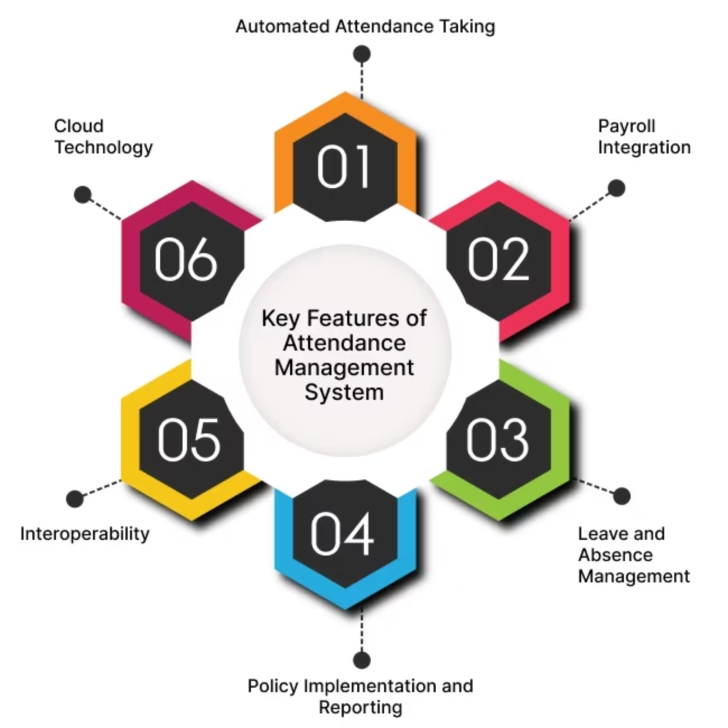
Smart Face Attendance Management System
This presentation outlines our Smart Face Attendance Management System, leveraging CNN with Streamlit, MTCNN, and face_recognition for efficient attendance tracking.

Slide 2
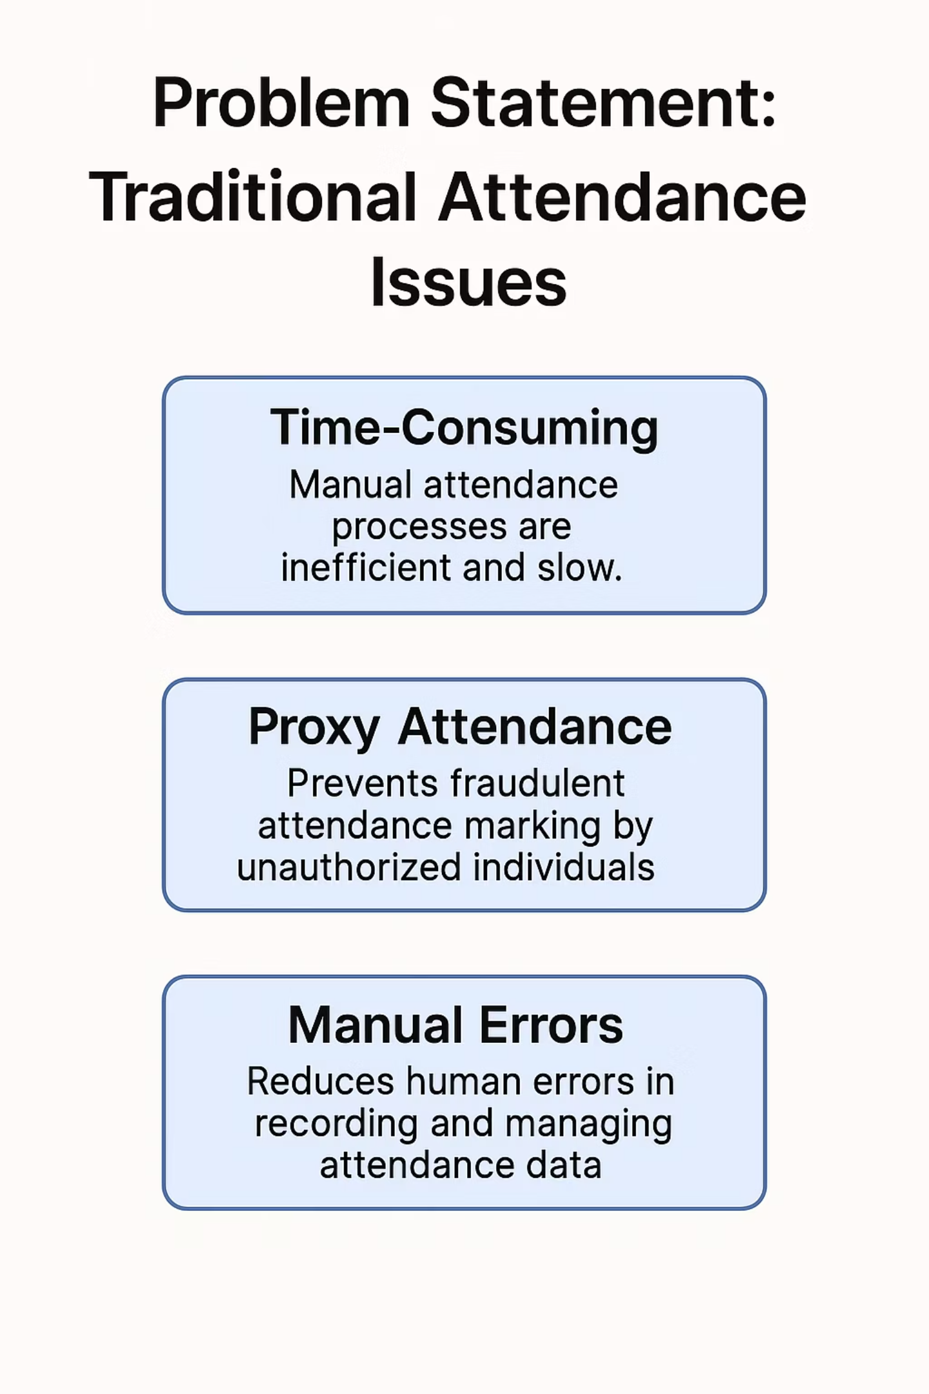



Problem Statement: Traditional Attendance Issues
Time-Consuming
Manual attendance processes are inefficient and slow.
Proxy Attendance
Prevents fraudulent attendance marking by unauthorized individuals.
Manual Errors
Reduces human errors in recording and managing attendance data.

Slide 3
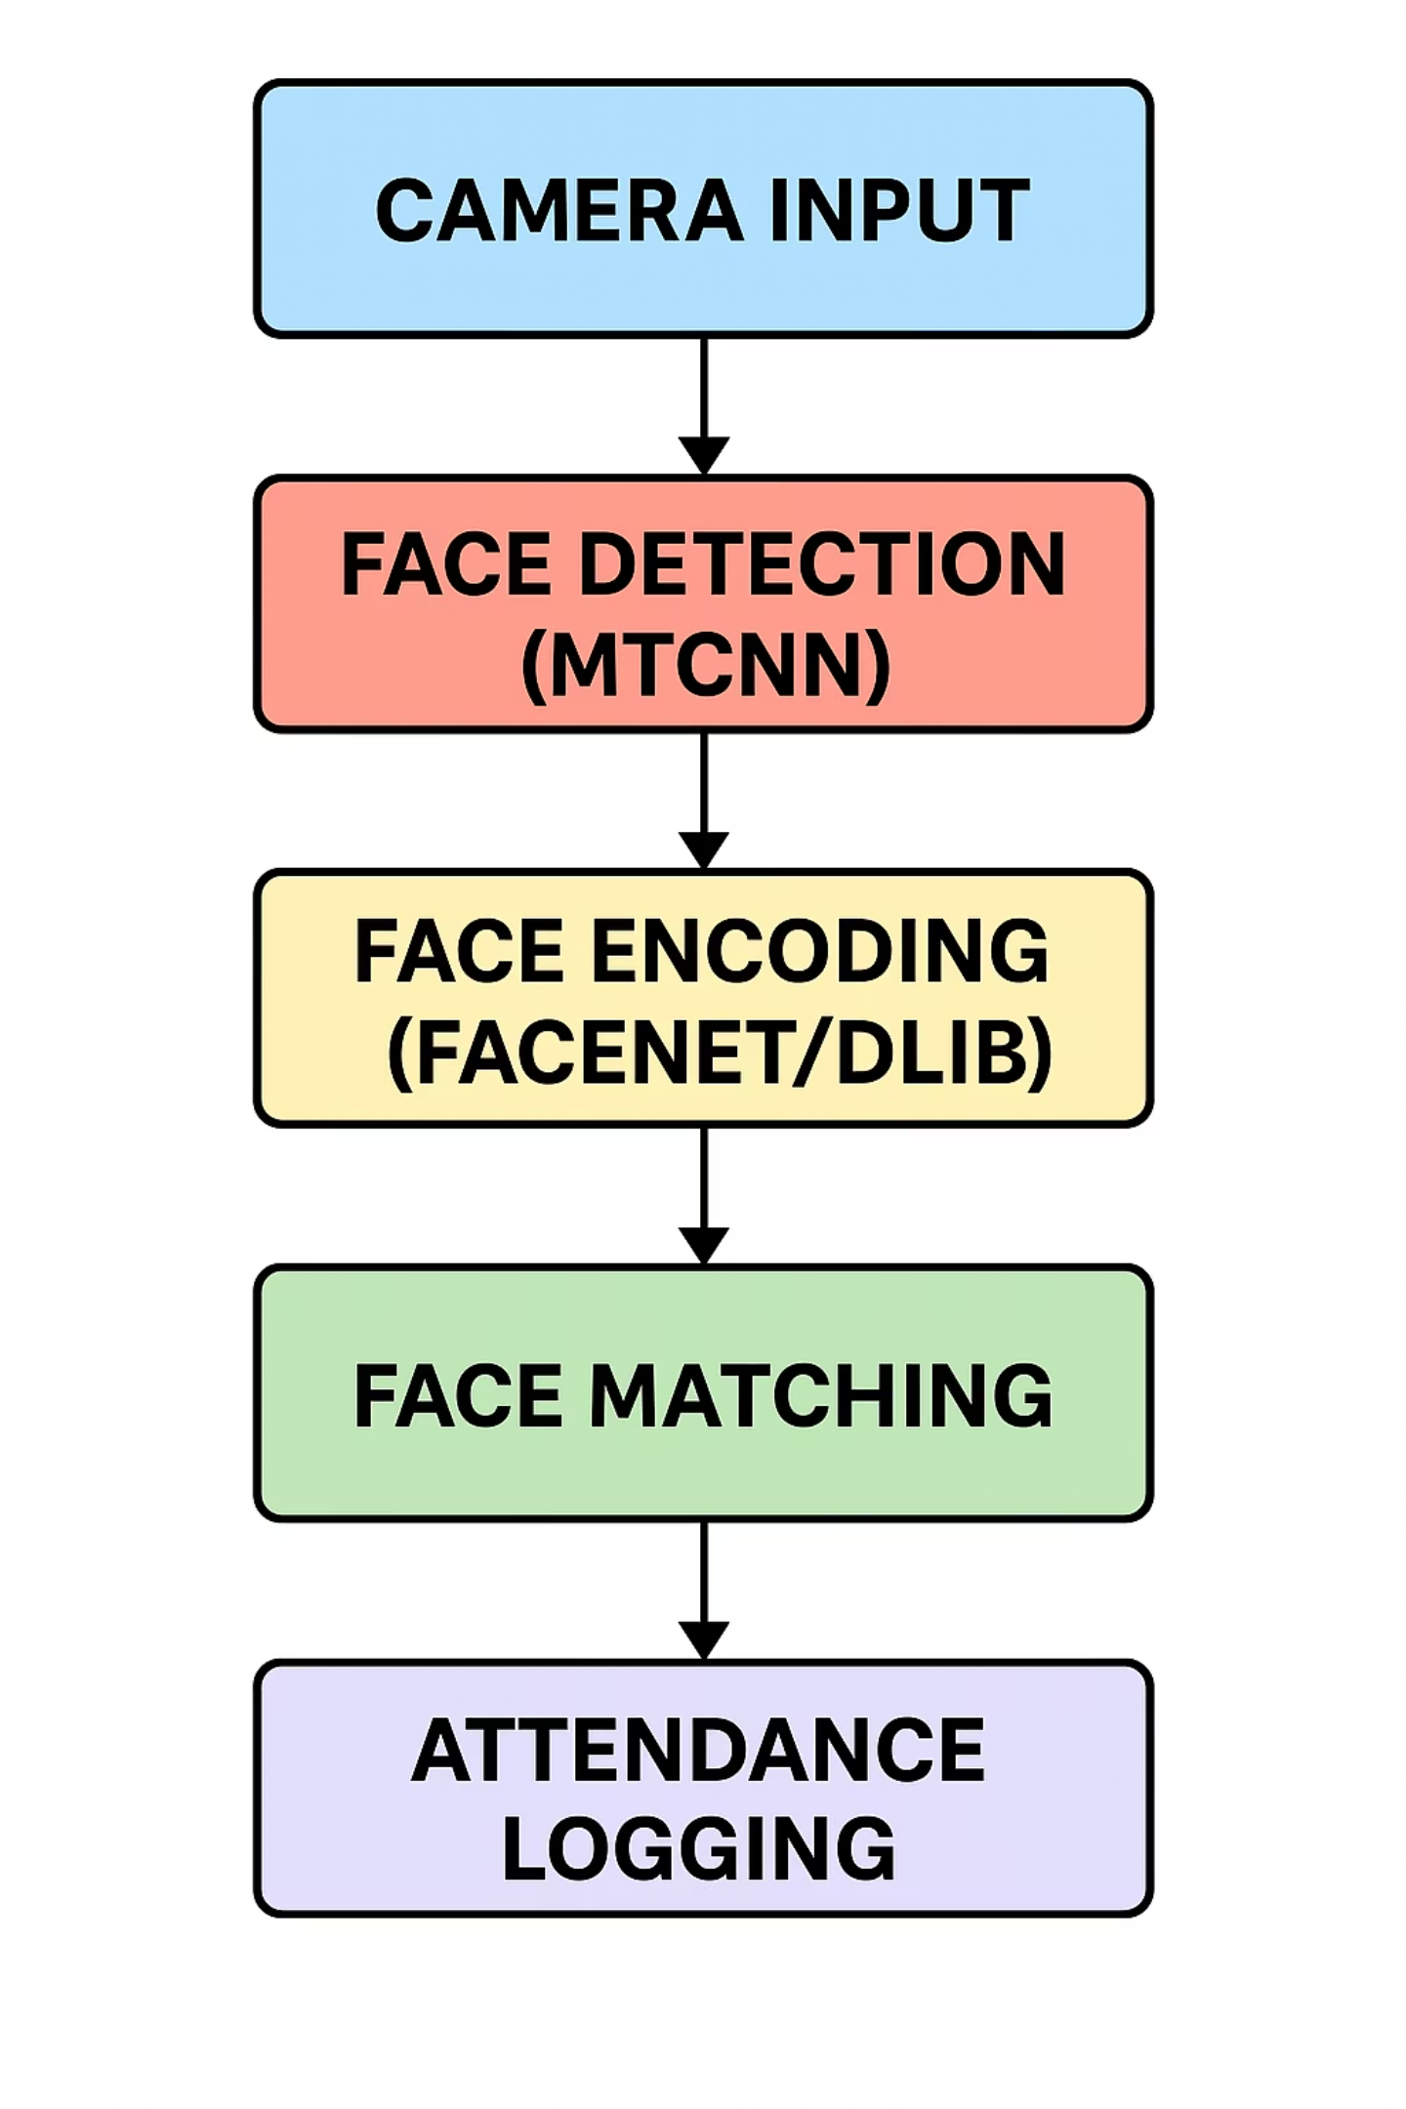

Proposed System Architecture
This system is powered by CNN, utilizing MTCNN, FaceNet, and Dlib for robust facial recognition.The system processes camera input through MTCNN for face detection, then encodes faces using FaceNet/Dlib. It matches faces against a threshold to mark attendance in a CSV.
MTCNN (Multi-task Cascaded Convolutional Networks)
P-Net (Proposal Network) – Generates candidate windows quickly.
R-Net (Refine Network) – Filters false positives and refines boxes.
O-Net (Output Network) – Further refines and detects facial landmarks (eyes, nose, mouth).
Dlib (with FaceNet-style Embedding)
Uses a deep CNN trained on FaceNet-style triplet loss.
Converts each face into a 128-dimensional vector (embedding).

Slide 4
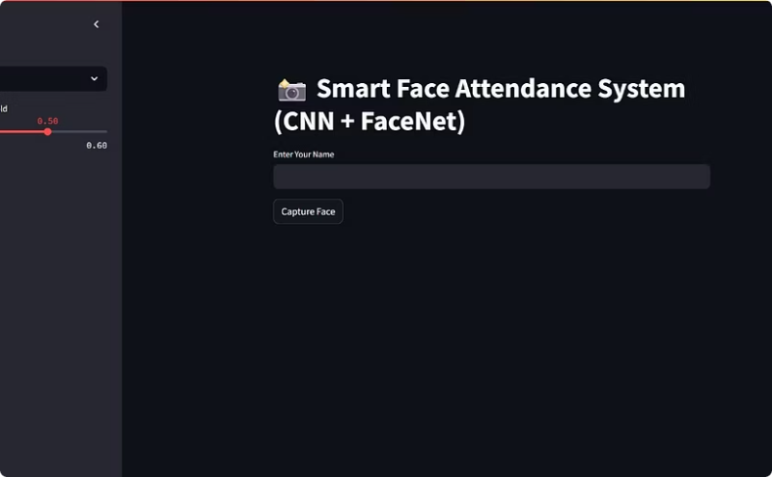
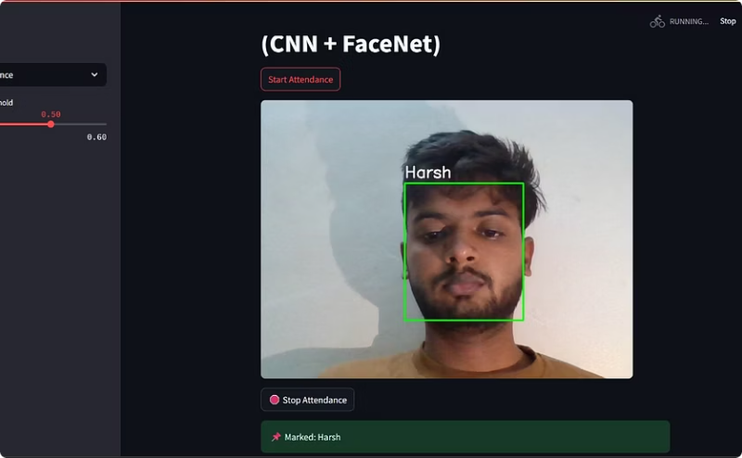
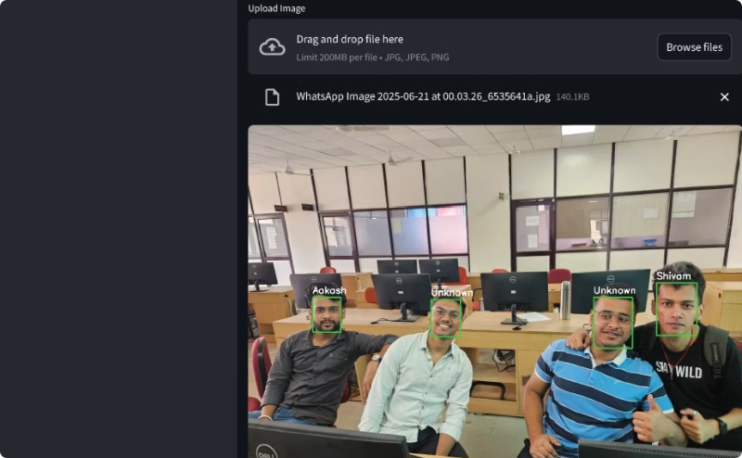
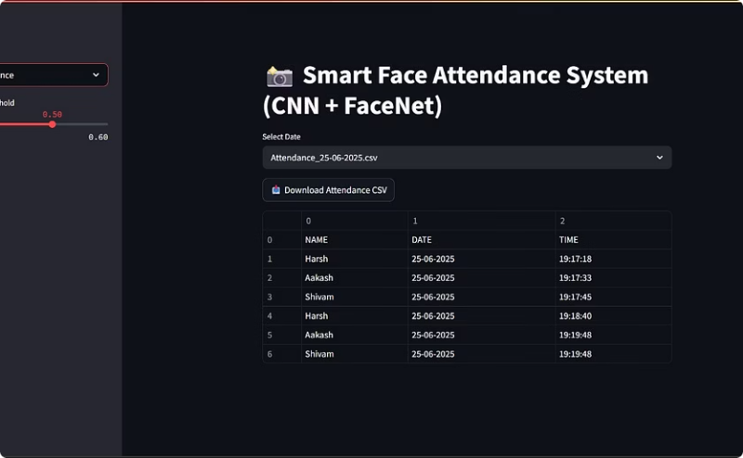
Modules of the System
Add Face
Mark Attendance
Upload Photo & Mark Attendance
View Attendance
Real-time camera capture for new user enrollment, allowing the system to detect, encode, and store the user's facial data instantly for future recognition.
Live webcam detection for daily attendance marking. Webcam captures real-time video, detects faces on-the-fly, and matches them against stored data to mark presence automatically.
Batch processing for attendance using uploaded photos. A match is confirmed if the distance is below a predefined threshold.
On successful match, name and time are saved in a CSV file, stored in the Attendance/ folder by date.

Slide 5
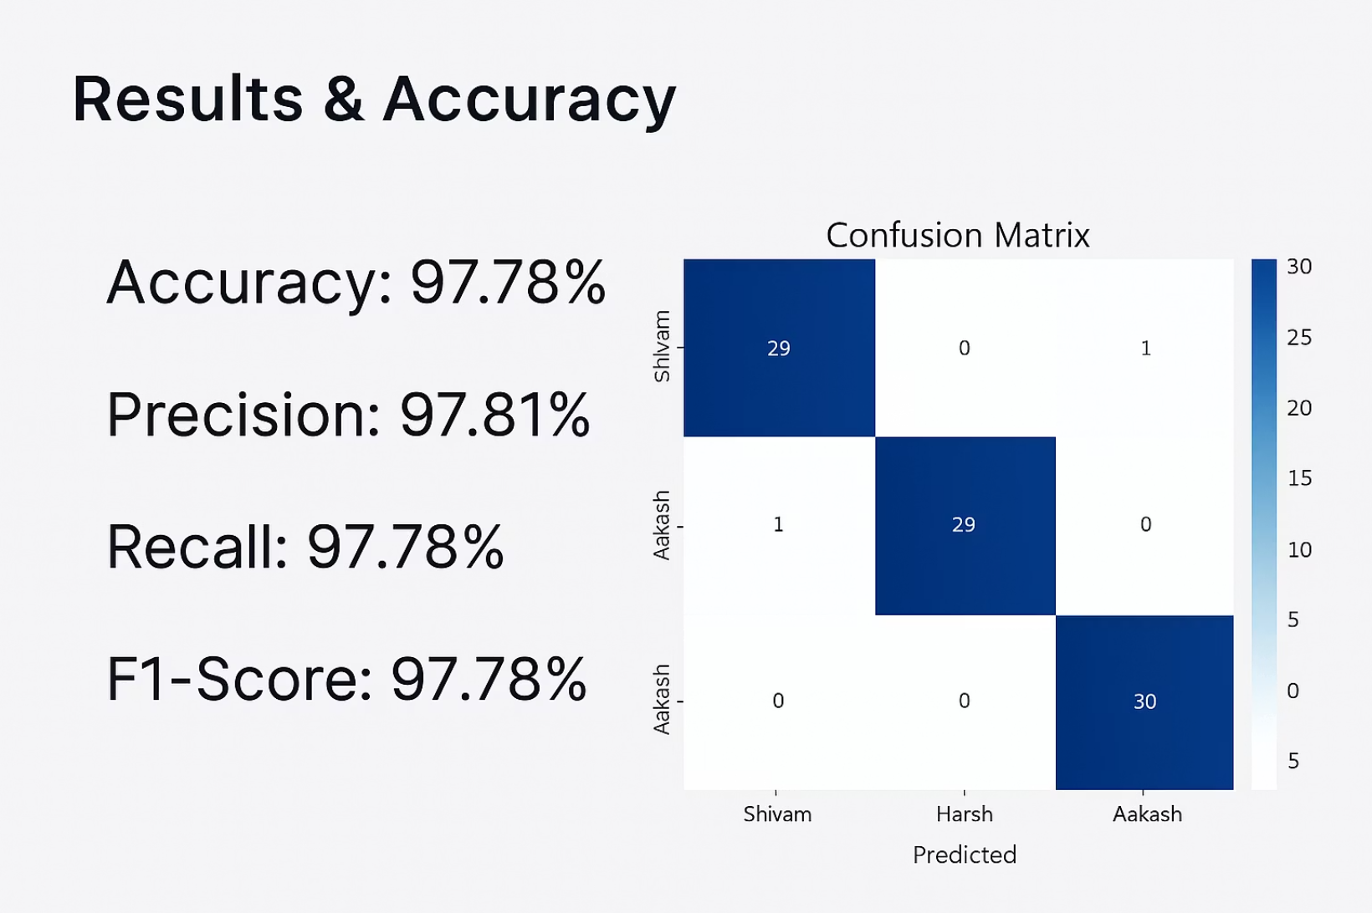
Results & Accuracy
Achieved 97.78% accuracy in face recognition.
High precision (97.81%), recall (97.78%), and F1-score (97.78%) indicate excellent model performance.
Confusion matrix shows accurate classification across all individuals with minimal errors.

Slide 6

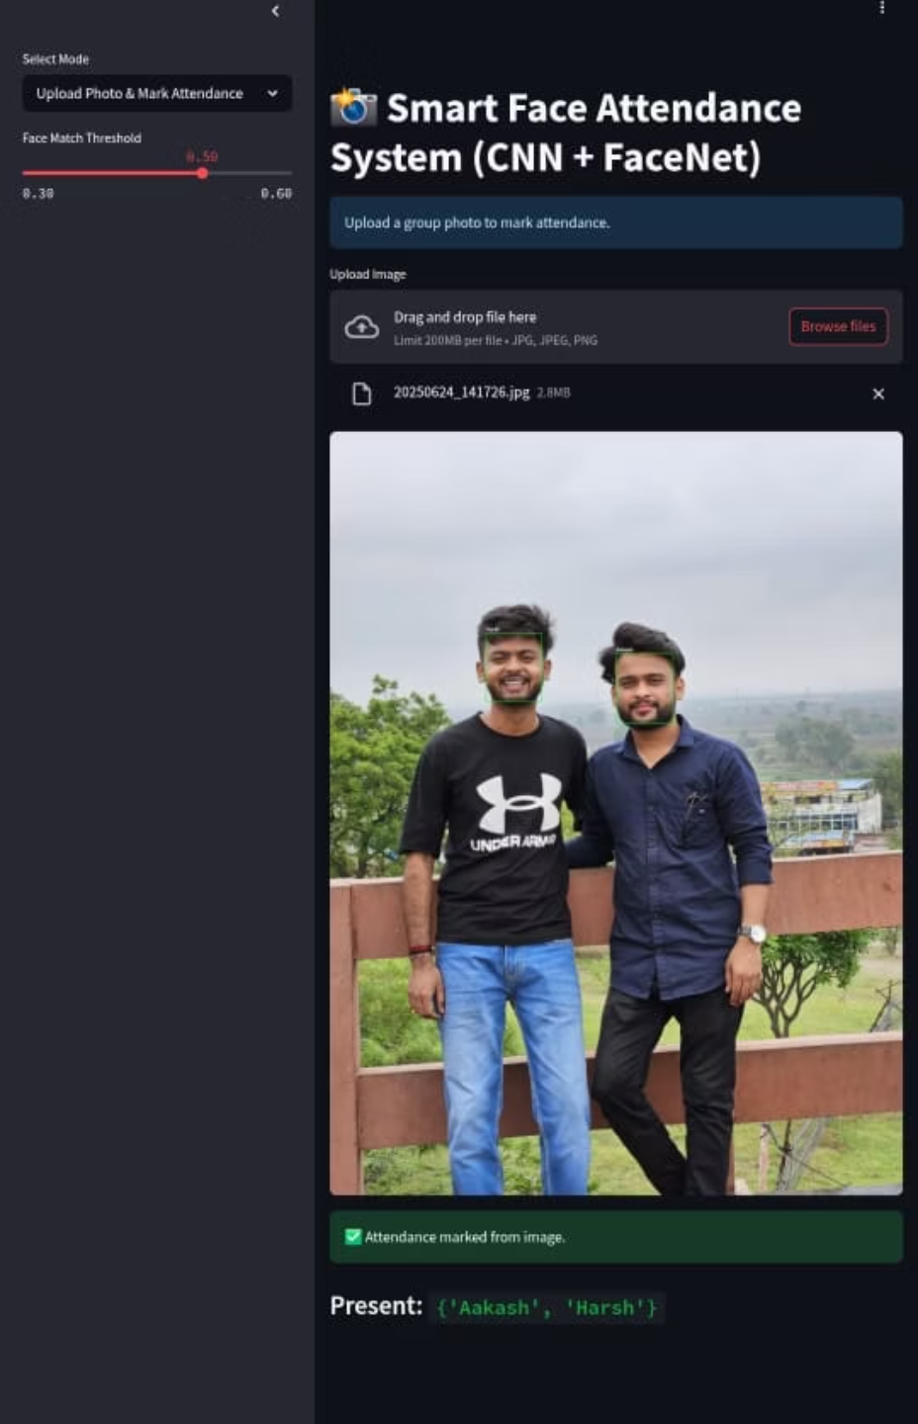
Conclusion & Future Scope
1
Automated, Accurate, Real-time
The system provides efficient and reliable attendance management.
2
Integrate with RFID/Card Systems
Enhance security and flexibility with additional access methods.
3
Add Cloud Sync or Dashboard
Enable remote access and comprehensive data visualization.
4
Mobile App Deployment
Expand accessibility and convenience for users on the go.

